Slide 1
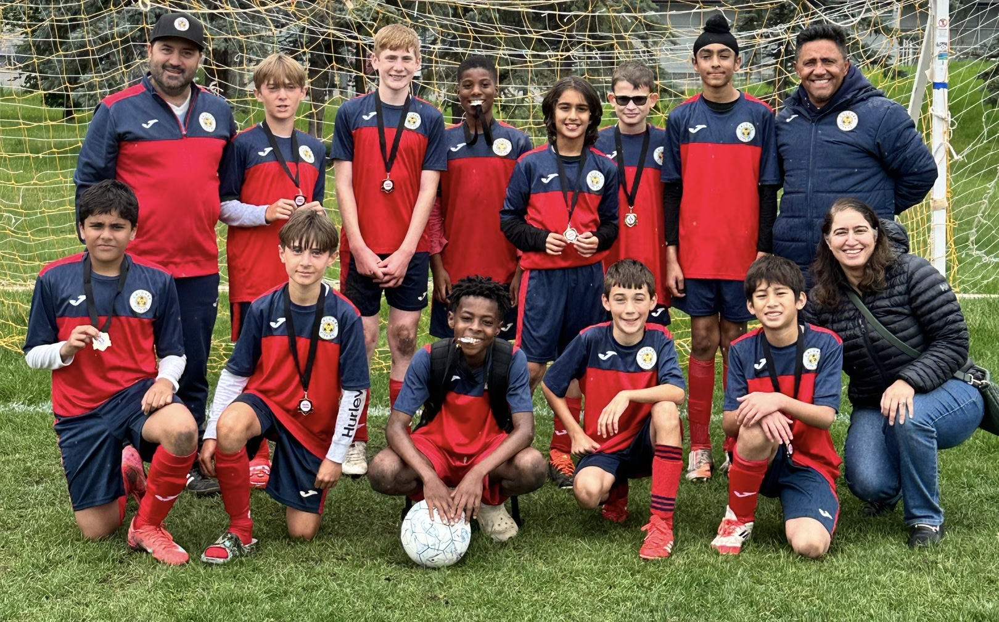

INDOOR SOCCER PROGRAM DETAILS 2025 /26

Slide 2
CALGARY CITY FOOTBALL CLUB
Following the LTPD Model by Canada Soccer
What is LTPD (Long-Term Player Development)?
LTPD is a developmental framework based on understanding human growth stages, from childhood to adulthood. It identifies specific stages with unique physical and psychological characteristics, allowing young athletes to train and compete in environments suited to their age and abilities. This approach ensures players perform their best while enjoying the game.
Calgary City FC and LTPD
At Calgary City FC, sessions are led by certified and knowledgeable technical staff who follow an age-specific curriculum and game model. The club prioritizes creating a safe and positive learning environment for players of all abilities, encouraging them to reach their potential.
Why Choose Calgary City FC?
Competitive team atmosphere.
Opportunities to develop technical skills and social skills.
A supportive environment to build lifelong friendships.
Joining the Calgary City CMSA program is perfect for aspiring athletes who want to grow in a structured and fun environment.
”NEVER STOP BELIEVING”

Slide 3
CALGARY CITY FC AID
Calgary City FC family AID
At our club, we are community-oriented, helping each other. We understand that not all families have the same opportunities. Our club offers payment installments (3), or you can make one full payment.
Three or more Sibling Discount
As part of our commitment to families, we offer a 25% discount when you register all 3 or more siblings to any of our CMSA programs U7 and Up.
First-Time Club Players
If your child has NEVER been registered with a club before, we would like to welcome you with a $25 discount on your first registration for any CMSA programs.
FREE SHOE EXCHANGE (Bring a pair OR Take a pair)
Donate your clean & gently used soccer shoes, or other gear for those who may need it.
New Referral Invite a NEW friend to join our club, and as an appreciation, you will receive a 10% discount on your registration fees, which can be credited to your account for each referral.
Bring a Friend Initiative
Help grow our girls’ soccer program!
If you bring a new female player to join the CMSA league, both you and your friend will receive a 25% discount on registration fees that will be credited to your club account. This offer is valid for new female players born between 2016 to 2021. Let’s build our community together—one teammate at a time!
FINANCIAL ASSISTANCE
To apply for financial assistance, please complete the applications online listed below, and submit completed applications.
KidSport
Jumpstart
Their Opportunity
”NEVER STOP BELIEVING”

Slide 4
VOLUNTEERS ARE ESSENTIAL FOR OUR CLUB
Volunteer as a coach, team manager, or let us know how you can help our club. It is fun and rewarding to give back to the community and support our young athletes!
Calgary City FC provides an environment for all coaches to develop and continue their learning and education. We provide coaches with the opportunity to complete their mandatory NCCP courses and community coaching stream, and we continue to support our coaches in getting a
C License certification.
We do require that all coaches, managers and BOD accept the Calgary City FC Harassment Policy agree to abide by the league Coach Code of Conduct and have a valid Police check. If you are interested in coaching, managing a team or helping our club, please do not hesitate to let us know. Info@calgarycityfc.ca
VOLUNTEER CREDIT PROGRAM
Credits will be offered at the END of the season for VOLUNTEERS to be used for the following season:
Head Coach $50
Team Manager $50
Other volunteer credits to be discussed
”NEVER STOP BELIEVING”

Slide 5
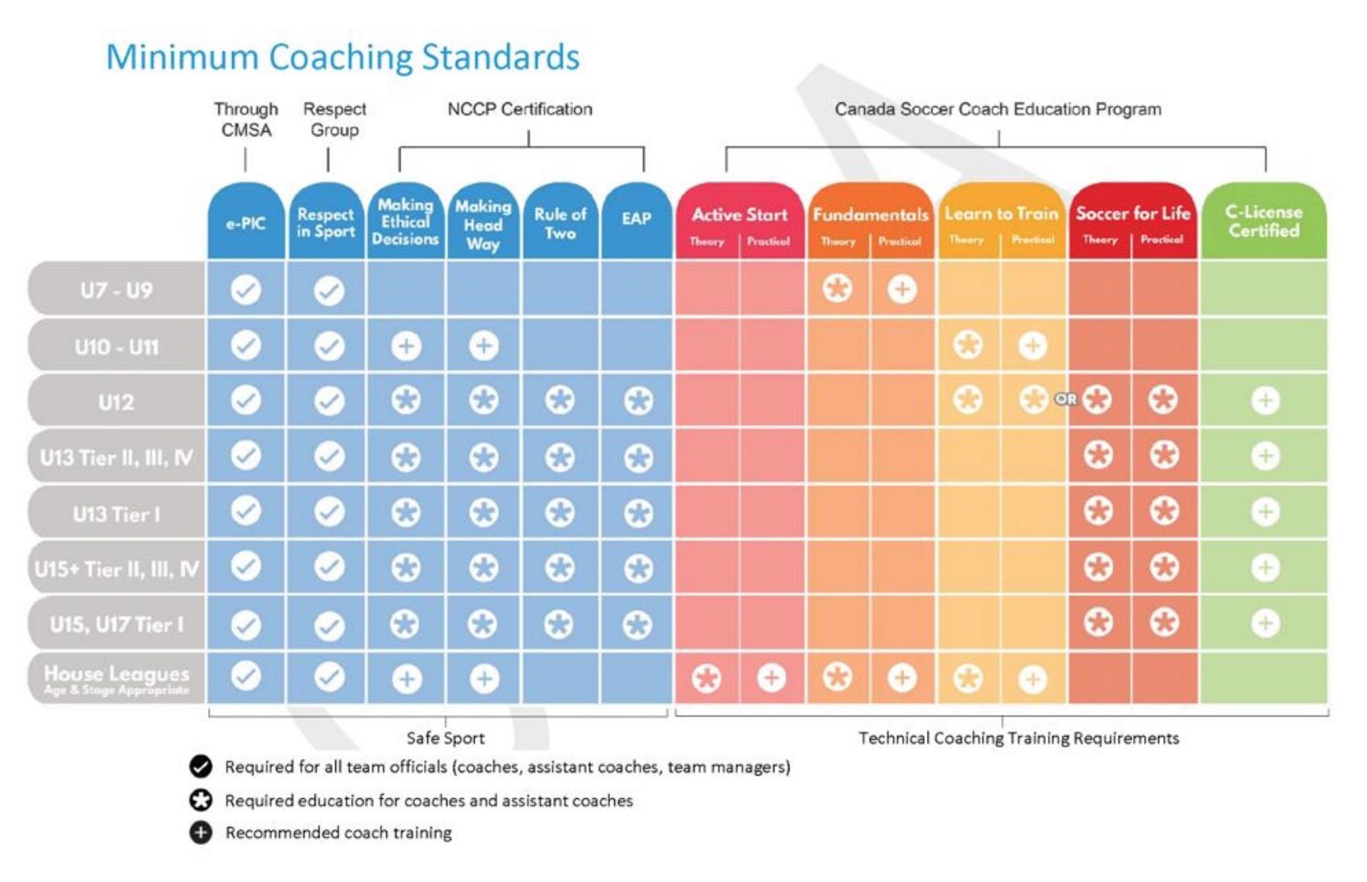

”NEVER STOP BELIEVING”

Slide 6
NEW Calgary City FC KIT
Gear Requirements:
Each player must have their shin pads and appropriate footwear for soccer.
For grassroots programs (U7 to U9), we have sponsorship from Tim Hortons and Shane Homes, which provide us with the players' uniforms.
Players new to the team or moving up to U10 will be required to purchase a CCFC Kit ($135), while existing players will pay $50. The kit includes a backpack, two jerseys (home and away), shorts, socks, a hoodie, and a training T-shirt (red or white). The set is mandatory – all players must wear the proper gear, with no exceptions, and players will keep the whole kit.
Education fee:
The $15 education fee covers costs for our team officials’ training, such as Respect in Sport, National Coaching Certification Program courses, coach licenses, and development.
Facility:
A $15 facility fee will be added to all registrations. Calgary City FC plans to have its own facility for its players. This fee will be used solely for facility development. Please visit our website for more details about the project.
* Education and facility fees are in addition to registration fees.
”NEVER STOP BELIEVING”

Slide 7

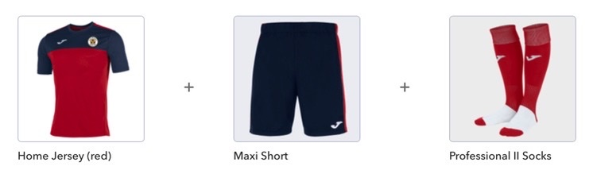
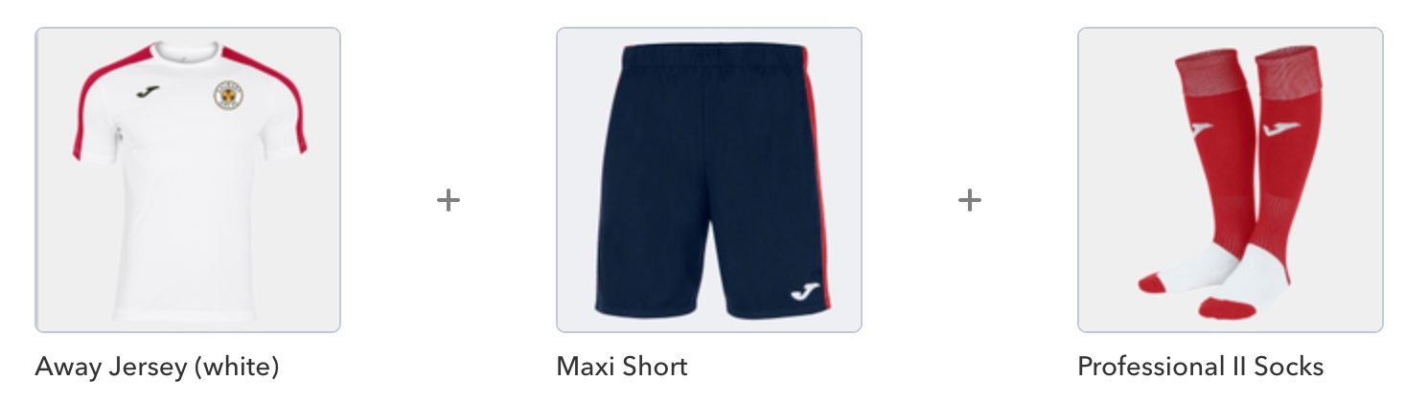
Calgary City FC uniform information and gear, please visit: https://calgarycityfc.itemorder.com/shop/home/

Slide 8
HOW TO REGISTER
To register for a program, visit Calgary City FC and click on the program that you want to register
Create a Demosphere account under your name - Parent/Guardian
Add a player – each player in your family needs to be added individually
Click on register now and pick the product you want to register your player in
Once you have added all the products you want to register click on “Add to Basket”
Enter the promo code if applicable and click on “Update Basket”
Click on “Check Out”
Complete the waiver(s)
Choose a payment method
Complete payment
Please note you only need one account per family. You do not need to create a new account if you already have an account and have registered previously.
Installment plans are available for all CMSA Development teams.
REFUNDS
All refund requests go to info@calgarycityfc.ca
• An Administration fee applies and will be deducted from all refunds. Grassroots (Under U9) $50 and CMSA U10 and up $100
• There will be NO refunds granted or issued after September 12, 2025
• The timeline for receiving a refund will be 8 to 12 weeks from receipt of the refund request.
DEADLINES
Non-injury-related refunds deadline before September 12, 2025
Injury-related (with a doctor’s note) Refunds might be offered on a case-by-case basis to be determined by the cost already incurred in the program.
Moving/relocating (with proof). Refunds might be offered on a case-by-case basis to be determined by the cost already incurred in the program.
CONDITIONS FOR REFUND
Will ONLY be considered under the following circumstances:
• Request is received before the deadline of September 12, 2025
• For non-injury-related requests - the player has not yet been placed on a team.
• Change in family circumstances, by moving out of the city or country.
• Injury to a player that will be medically deemed unable to play for the remainder of the season, accompanied by a doctor’s note.

Slide 9
Grassroots Active start
U4 - U5 - U6 (2022/2021/2020) Co-Ed
    Nov 04 - Feb 24 (Break Dec 17 to Jan 05)
    15 Sessions/games
    Tuesdays at 4:45 pm (U4) and at 5:30 pm U5/U6
    at North Point School (2445 23Ave SW)
    Parental Participation may be required
    Includes a club soccer training uniform
    Cost $300
      Fun Developmental Games
      Physical Literacy
      Running, Jumping, Rolling, Kicking
      Balance, Coordination, Changing directions
      Meet new friends
      Foster love for the ball
What to Bring:
Water, indoor soccer shoes or running shoes, and shin guards
Training Kit: Provided by CCFC
TO REGISTER CLICK HERE
*You will need to create a family profile on Demosphere, add each player individually and choose the program(s) you would like to register.

Slide 10
Grassroots Fundamentals CMSA
U7 – U8 (2019/2018)
Season Oct 20 - Feb 21
• 16 Technical training sessions at North Point School (2445 23Ave SW)
Monday 5:00 to 6:00 U7 and 6:00 to 7:00 pm U8
• 12 Saturdays CMSA Matches at Calgary West Soccer Centre
. Formats - 3v3 U7 and 4V4 U8 (3 matches) 15 min each
• Includes club soccer training jersey and FULL match uniform
• $400
* Christmas Break is Dec 13 – Jan 04
      Fun Learning Developmental Soccer Games
      Physical Literacy
      Focus on Developing soccer skills
      Decision-making and creativity
      Controlling 1V1s and transitions
      Team effort
Registration is now open
*You will need to create a family profile on Demosphere, add each player individually and choose the program(s) that you would like to register.

Slide 11
CMSA Grassroots Developmental
U9 (2017)
Season Oct 20 to Feb 21
• 14 Tech training sessions on Monday from 7:00 to 8:15 pm
. 16 Practice sessions on Wednesday from 7:00 to 8:15 pm
at North Point School (2445 23 Ave SW)
• 14 CMSA Matches – Saturdays at SHWSD Formats - 5v5 (Two 25-minute matches)
• Includes club soccer training jersey and FULL Matches uniform
Cost $625
* Christmas Break is Dec 13 – Jan 04
      Soccer Technique
      1V1 Dominance
      Soccer game IQ
      Trial and Error
      Small-sided game
      Balance, Coordination, Changing directions
Registration is now open
*You will need to create a family profile on Demosphere, add each player individually and choose the program(s) that you would like to register.

Slide 12
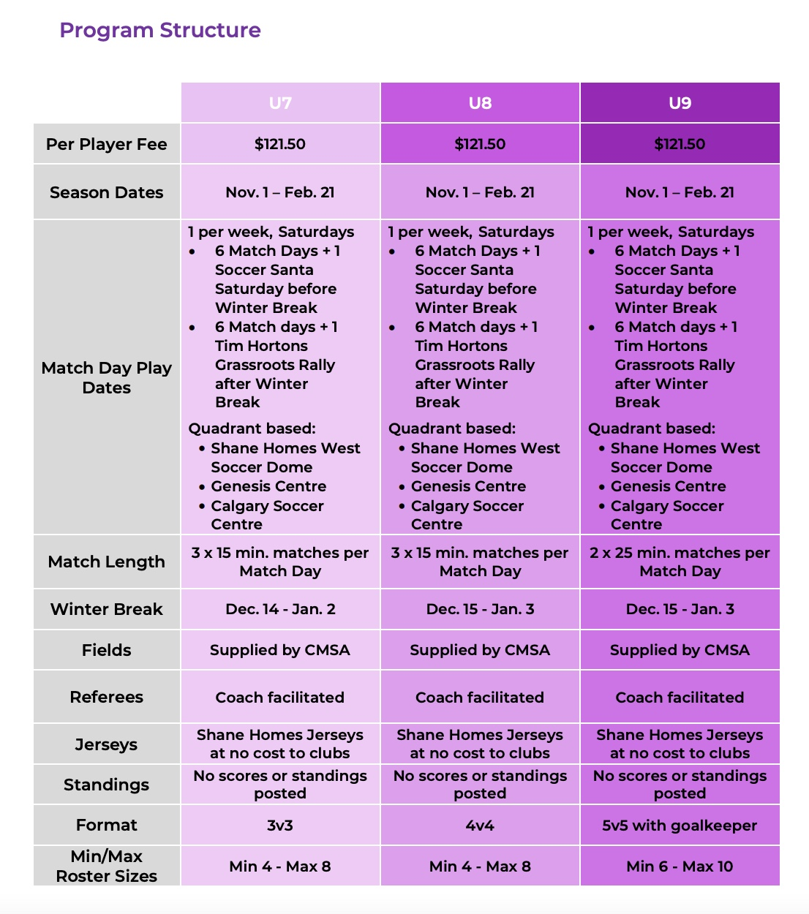


Slide 13
CMSA Developmental
U10 (2016)
Season Oct 14 to Mar 02
• 14 Tech training sessions on Tuesday from 6:30 to 8:00 pm
. 16 Practice sessions on Thursday from 6:30 to 8:00 pm
at North Point School (2445 23 Ave NW)
• 14 CMSA Matches – Any day of the week Format - 7v7 (50 mins match)
• Players new to the team or moving up to U10 will be required to purchase a CCFC Kit ($135). The kit includes a backpack, two jerseys (home and away), shorts, socks, a hoodie, and a training T-shirt (red or white).
Cost $750
* Christmas Break is Dec 22 – Jan 05
      Soccer Technique
      1V1 Dominance
      Soccer game IQ
      Trial and Error
      Small-sided game
      Balance, Coordination, Changing directions
Registration is now open
*You will need to create a family profile on Demosphere, add each player individually and choose the program(s) that you would like to register.

Slide 14
CMSA Developmental PLUS
U11 (2015)
Season Oct 14 to Mar 02
• 14 Tech training sessions on TURF Wednesday from 5:30 to 6:30 pm
. 16 Practice sessions Tuesdays from 6:15 to 7:15 pm at University School (3035 Utah Dr NW)
• 14 CMSA Matches – Any day of the week Formats - 7v7 (50 mins match)
• Players new to the team or moving up to U10 will be required to purchase a CCFC Kit ($135), while existing players will pay $50. The kit includes a backpack, two jerseys (home and away), shorts, socks, a hoodie, and a training T-shirt (red or white). The set is mandatory – all players must wear the proper gear, with no exceptions, and players will keep the whole kit.
Cost $1050
* Christmas Break is Dec 22 – Jan 05
      Soccer Technique
      Soccer game IQ
      Trial and Error
      Small-sided game
      Tactical games
Registration is now open
*You will need to create a family profile on Demosphere, add each player individually and choose the program(s) that you would like to register.

Slide 15
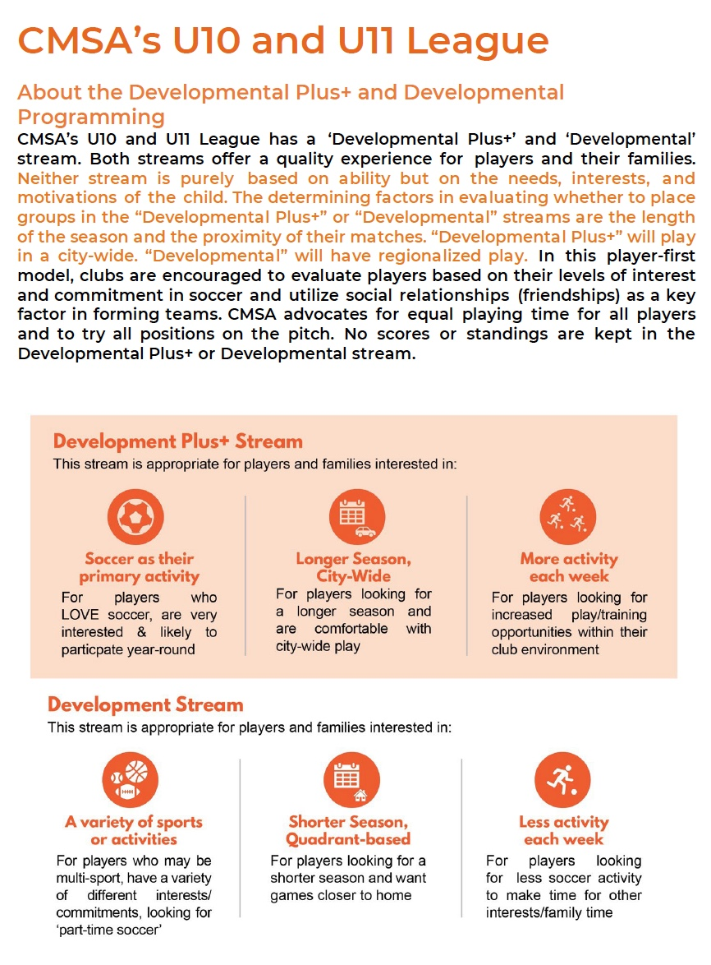
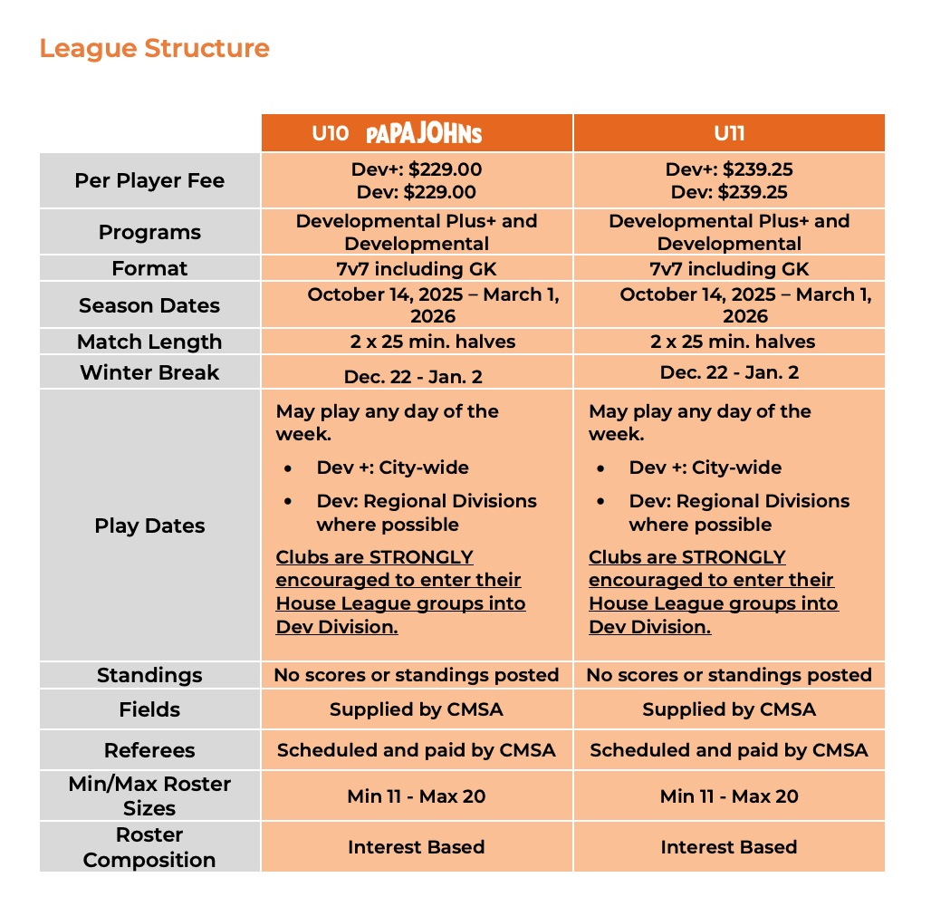

Slide 16
CMSA Developmental PLUS
U12 (2014)
Season Oct 14 to Mar 02
• 14 Tech training sessions on TURF Wednesday from 6:30 to 7:30 pm
. 16 Practice sessions Tuesdays from 7:15 to 8:15 pm at University School (3035 Utah Dr NW)
• 14 CMSA Matches – Any day of the week Formats - 7v7 (50 mins match)
• Players new to the team or moving up to U10 will be required to purchase a CCFC Kit ($135), while existing players will pay $50. The kit includes a backpack, two jerseys (home and away), shorts, socks, a hoodie, and a training T-shirt (red or white). The set is mandatory – all players must wear the proper gear, with no exceptions. Players will keep the entire kit.
Cost $1050
* Christmas Break is Dec 22 – Jan 05
      Soccer Technique
      Soccer game IQ
      Trial and Error
      Small-sided game
      Tactical games
Registration is now open
*You will need to create a family profile on Demosphere, add each player individually and choose the program(s) that you would like to register.

Slide 17
CMSA Developmental
U13 (2013)
Season Oct 014 to Mar 02
• 14 Tech training sessions on TURF Wednesday from 6:30 to 7:30 pm
. 16 Practice sessions Tuesdays from 8:15 to 9:15 pm at University School (3035 Utah Dr NW)
• 14 CMSA Matches – Any day of the week Formats - 7v7 (50 mins match)
. 8 Fitness sessions – Monday from 6:15 to 7:30 pm
• Players new to the team or moving up to U10 will be required to purchase a CCFC Kit ($135), while existing players will pay $50. The kit includes a backpack, two jerseys (home and away), shorts, socks, a hoodie, and a training T-shirt (available in red or white). The set is mandatory – all players must wear the proper gear, with no exceptions. Players will keep the entire kit.
Cost $1125
* Christmas Break is Dec 22 – Jan 05
      Soccer Technique
      Soccer game IQ
      Small-sided game
      Decision making
      Trial and Error
      Transitions Defend/Attack
      Tactical game
Registration is now open
*You will need to create a family profile on Demosphere, add each player individually and choose the program(s) that you would like to register.

Slide 18
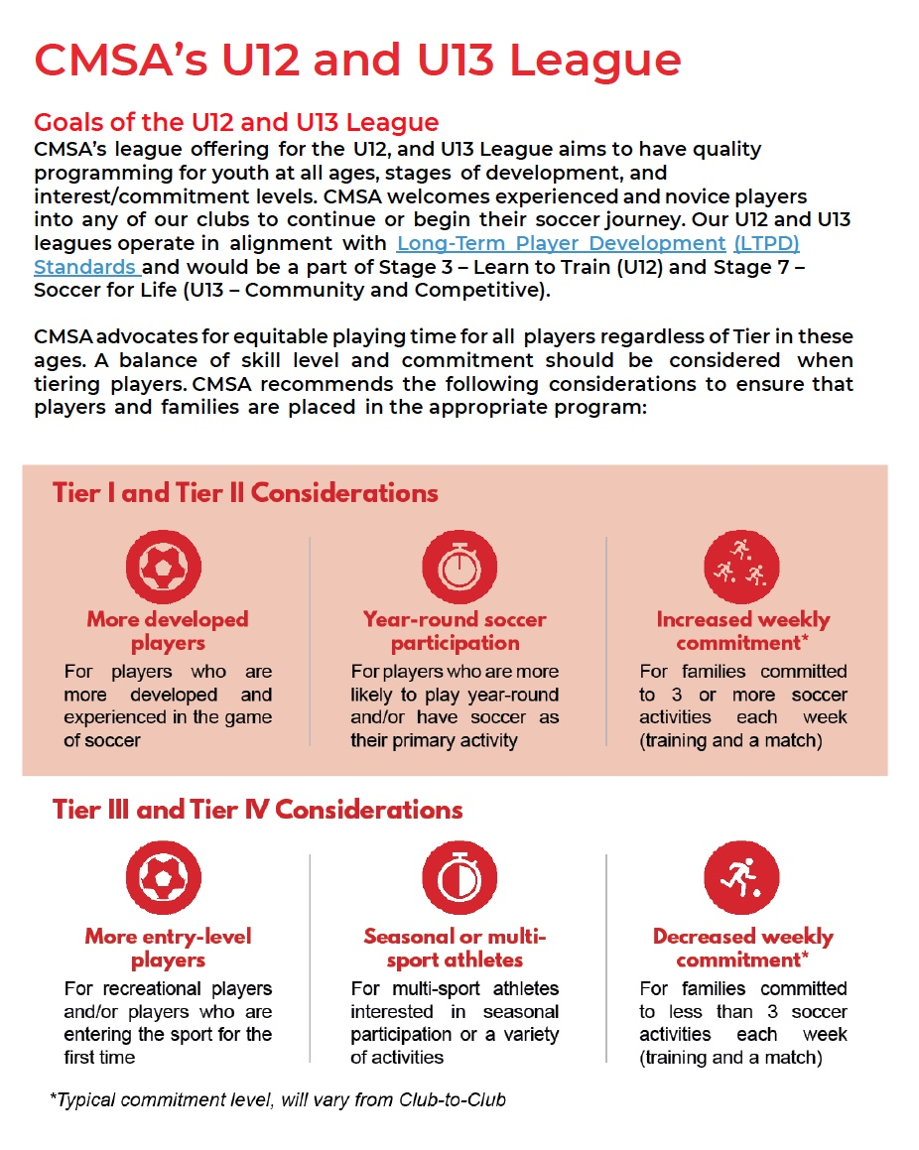
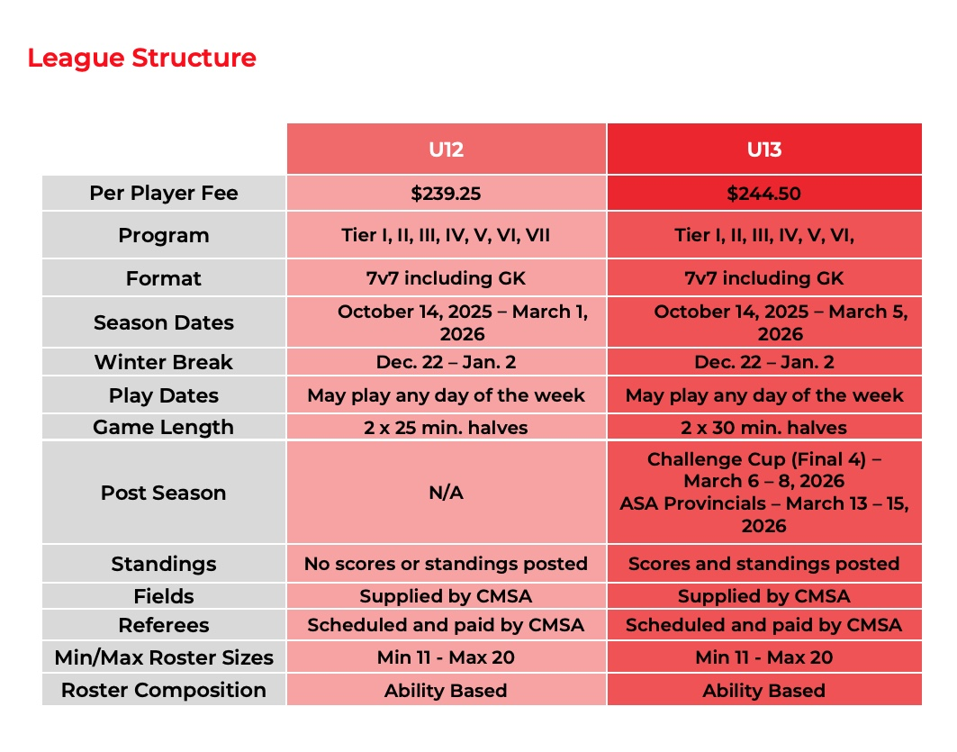

Slide 19
CMSA Developmental
U14 - U15 (2012-2011)
Season Oct 014 to Mar 02
• 14 Tech training sessions on TURF Wednesday from 7:30 to 8:30 pm
. 16 Practice sessions Fridays from 6:30 to 7:45 pm at University School (3035 Utah Dr NW)
• 14 CMSA Matches – Any day of the week Formats - 7v7 (50 mins match)
. 8 Fitness sessions – Monday from 7:30 to 9:00 pm
• Players new to the team or moving up to U10 will be required to purchase a CCFC Kit ($135), while existing players will pay $50. The kit includes a backpack, two jerseys (home and away), shorts, socks, a hoodie, and a training T-shirt (available in red or white). The set is mandatory – all players must wear the proper gear, with no exceptions. Players will keep the entire kit.
Cost $1350
* Christmas Break is Dec 22 – Jan 05
      Soccer Technique
      Soccer game IQ
      Small-sided game
      Decision making
      Trial and Error
      Transitions Defend/Attack
      Tactical game
Registration is now open
*You will need to create a family profile on Demosphere, add each player individually and choose the program(s) that you would like to register.

Slide 20
CMSA Developmental
U16 (2010)
Season Oct 14 to Mar 05
• 14 Tech training sessions on TURF Wednesday from 8:30 to 9:30 pm
. 16 Practice sessions Fridays from 7:45 to 9:00 pm at University School / Queen Elizabeth HS
• 14 CMSA Matches – Any day of the week Formats - 7v7 (50 mins match)
. 8 Fitness sessions – Monday from 7:30 to 9:00 pm
• Players new to the team or moving up to U10 will be required to purchase a CCFC Kit ($135), while existing players will pay $50. The kit includes a backpack, two jerseys (home and away), shorts, socks, a hoodie, and a training T-shirt (available in red or white). The set is mandatory – all players must wear the proper gear, with no exceptions. Players will keep the entire kit.
Cost $1400
* Christmas Break is Dec 22 – Jan 05
      Soccer Technique
      Soccer game IQ
      Small-sided game
      Decision making
      Trial and Error
      Transitions Defend/Attack
      Tactical game
Registration is now open
*You will need to create a family profile on Demosphere, add each player individually and choose the program(s) that you would like to register.

Slide 21
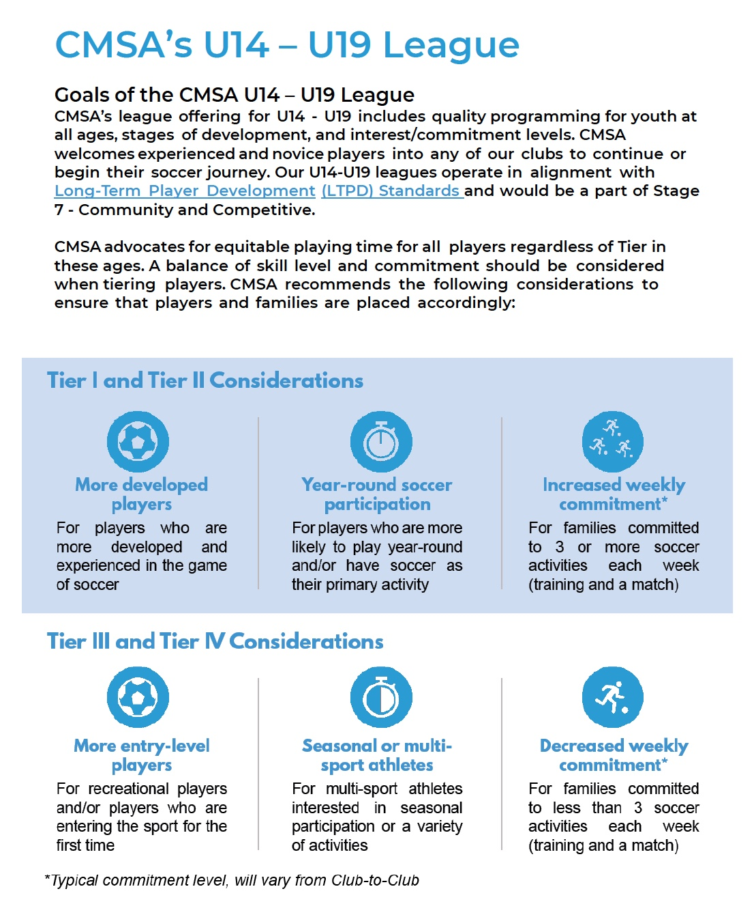
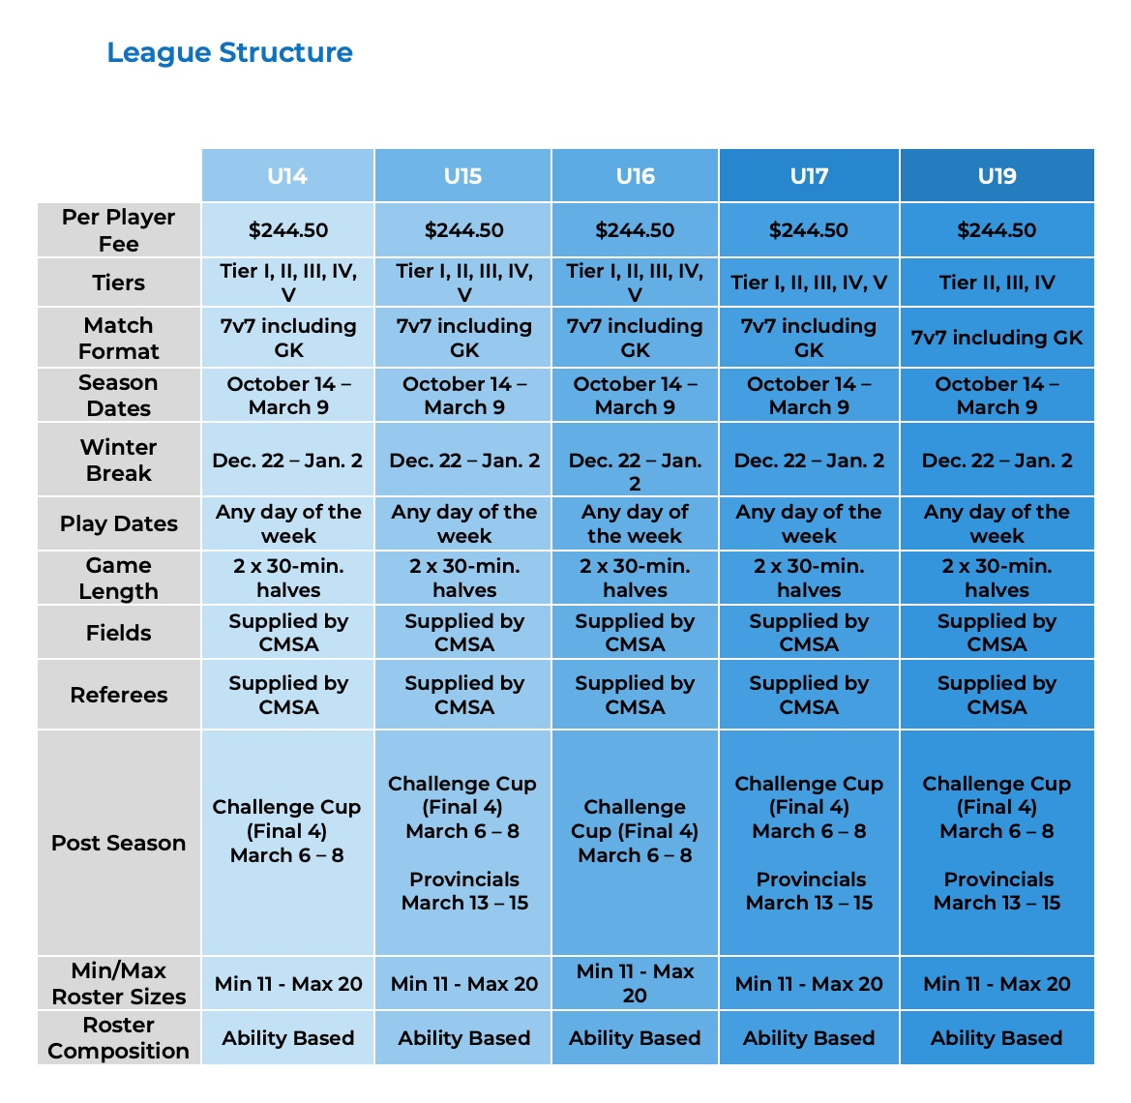

Slide 22
Academy Skills Programs
Just for FUN!
This initiative is to invite your buddy to play “The Beautiful Game” with you for FREE
Fridays during the indoor season for 1.5 hours at University School (3035 Utah Dr NW)
Nov 07 and 14 Dec 12 and 19 Jan 09 and 23 Feb 06 and 20
Finishing
7 Sessions Sundays, Nov 02 to Dec 14, 11:00 am to 12:15 pm, North Point School $160
Goalkeeper
8 Sessions Fridays from 6:30 to 7:30 PM
Nov 07 and 14 Dec 12 and 19 Jan 09 and 23 Feb 06 and 20
$ 160 (Free for our club players)
Open to anyone who wants to improve goalkeeping skills
“NEVER STOP BELIEVING”

Slide 23
POLICIES
Calgary City FC adheres to CMSA Policies
Accessibility, Equity, Diversity and Inclusion Policy
Anti Discrimination Policy
ASA Severe Weather and Air Quality Policy
Bloodborne Pathogen Policy
Code of Conduct to Protect Children
Concussion Policy
Extreme Heat Guidelines
Governance Policy
Harassment Policy
Privacy Policy

Slide 24


Thank you to our sponsors
Please check other sponsorship opportunities

